Slide 1


VESTIGE
किसान मित्र प्रोजेक्ट

Slide 2

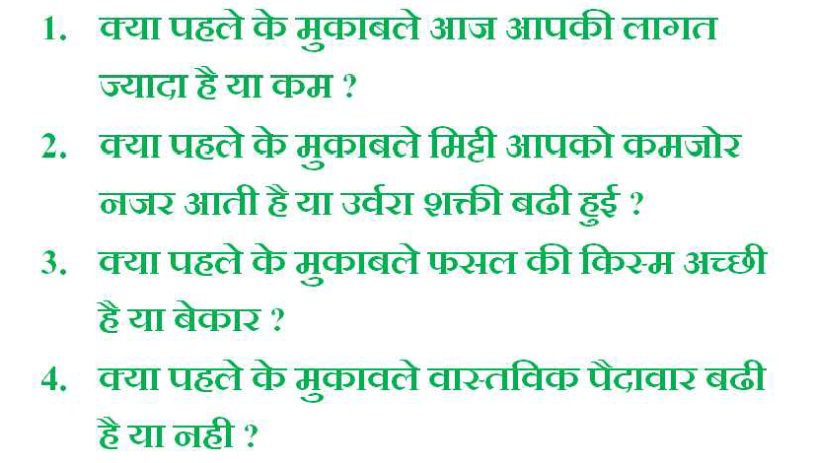



Slide 3
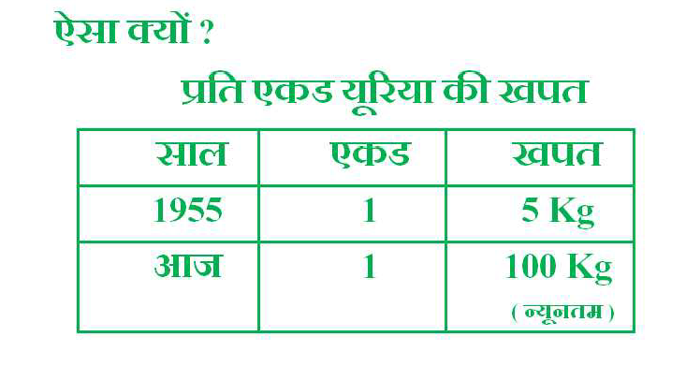

Slide 4
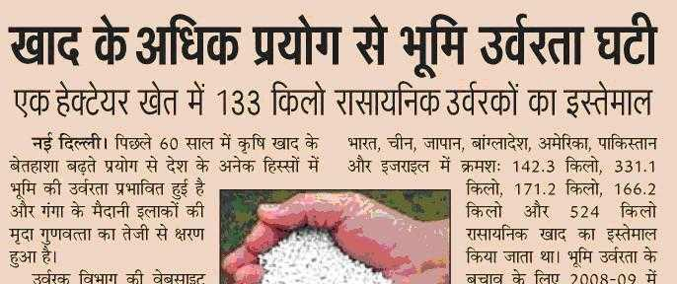
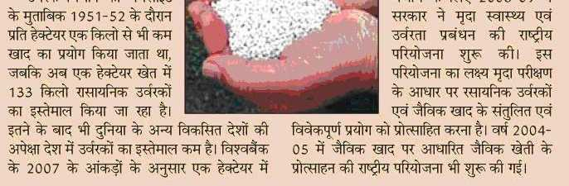

Slide 5

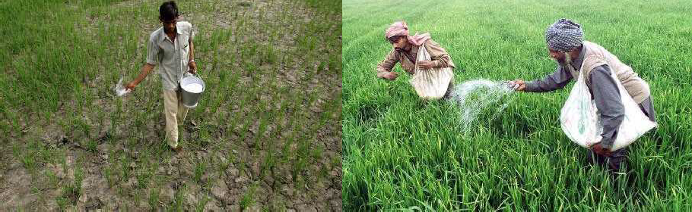

Slide 6

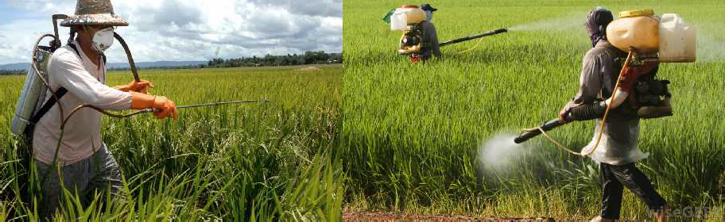

Slide 7
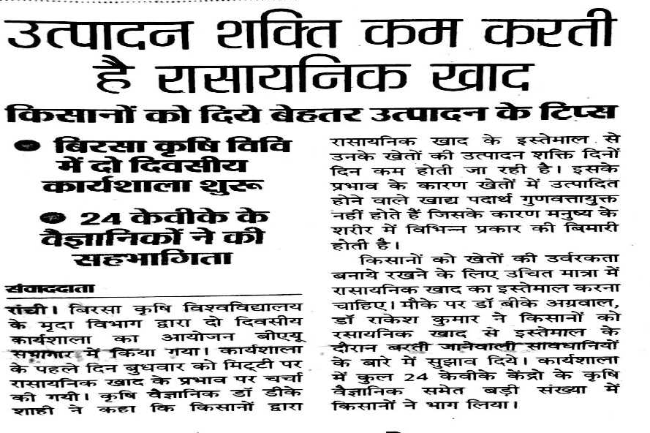

Slide 8


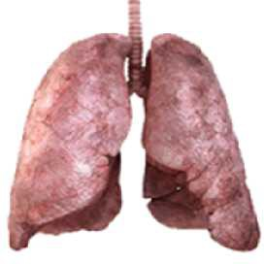

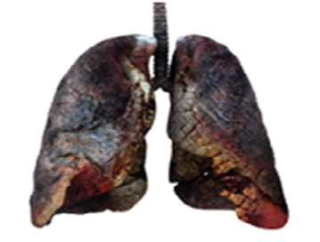

Slide 9

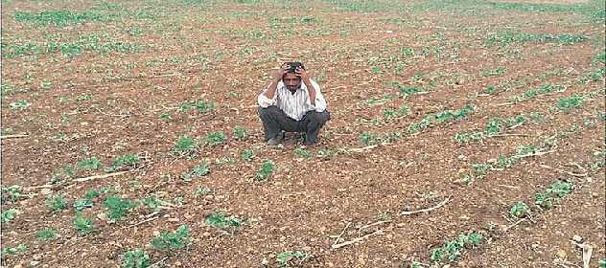


Slide 10


Slide 11

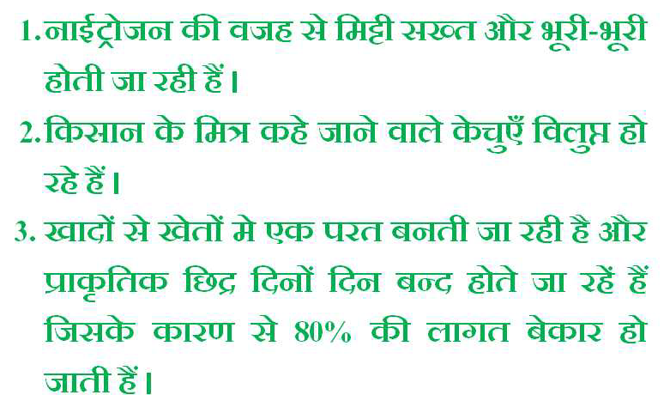

Slide 12


Slide 13

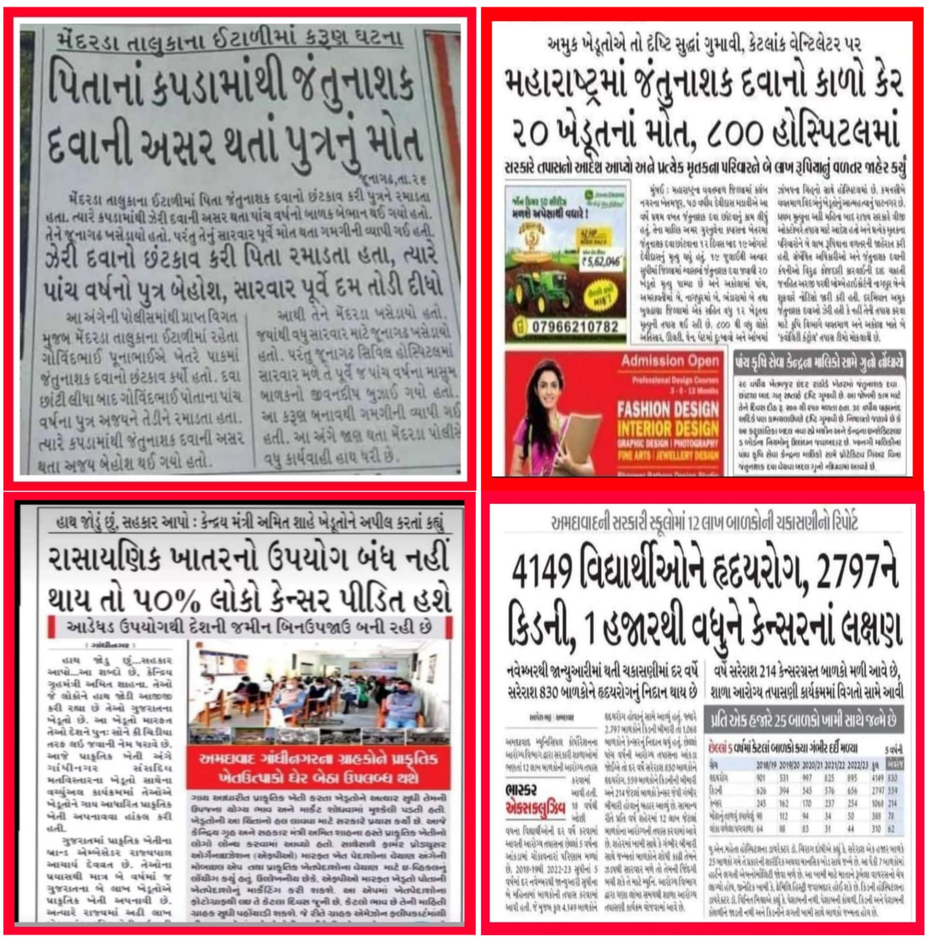

Slide 14
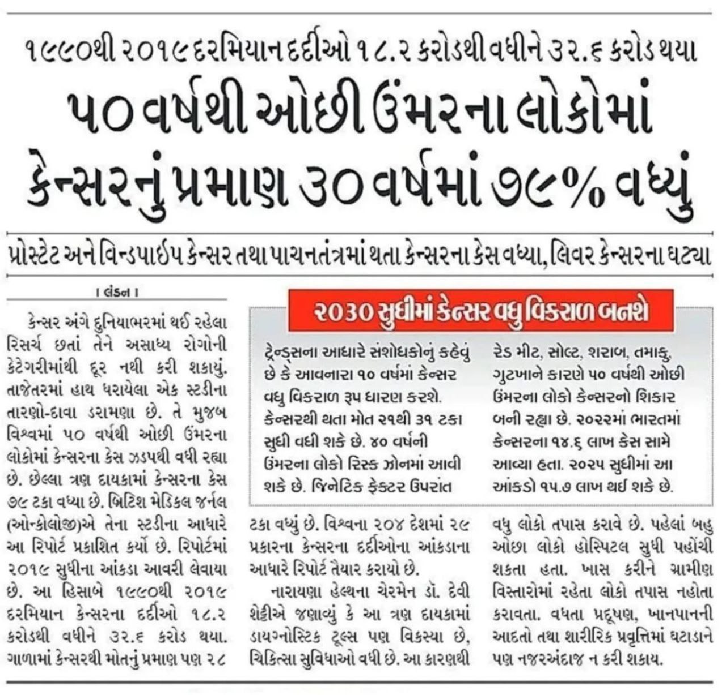

Slide 15
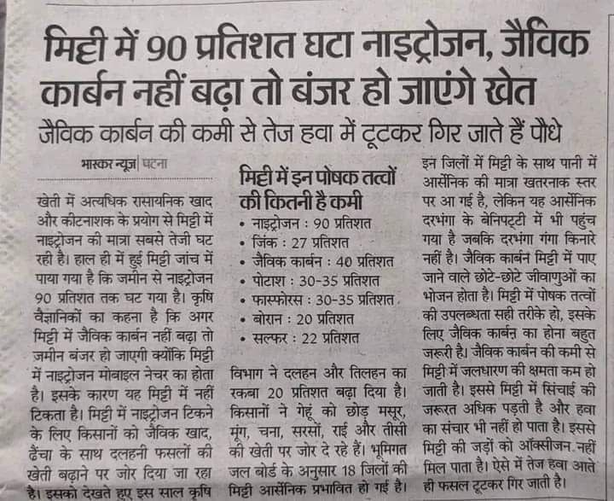
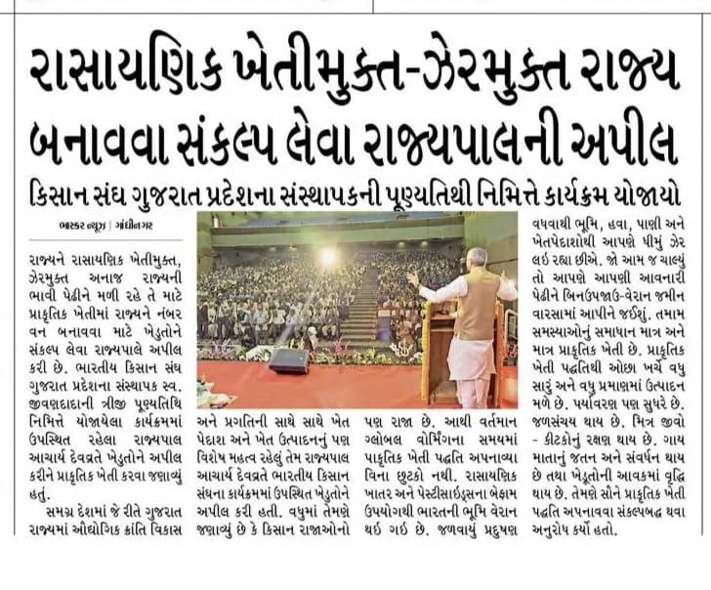

Slide 16
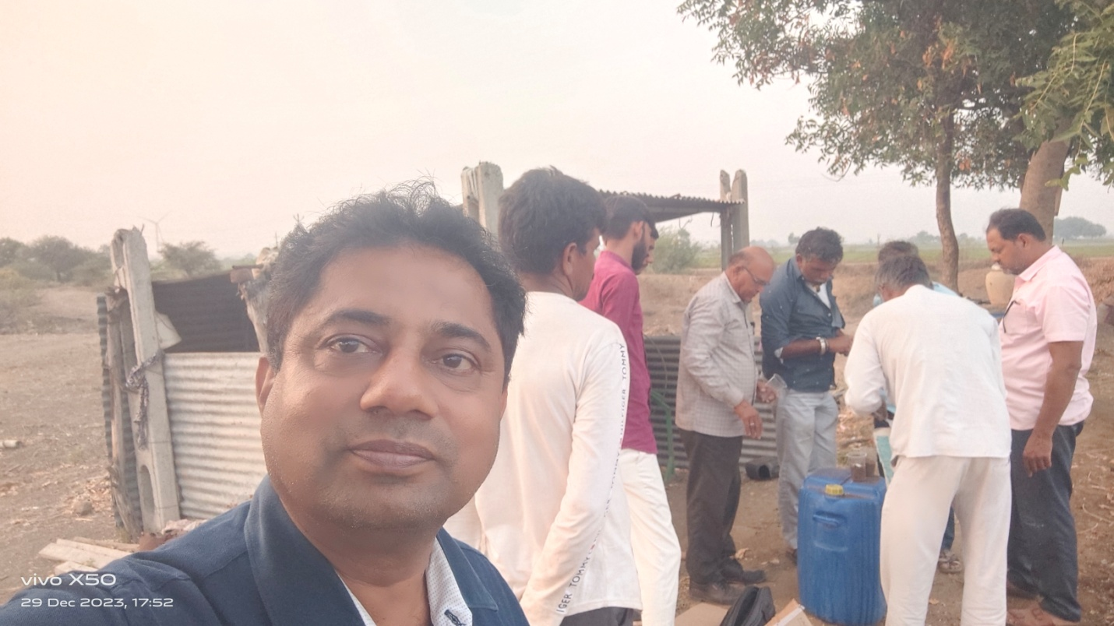
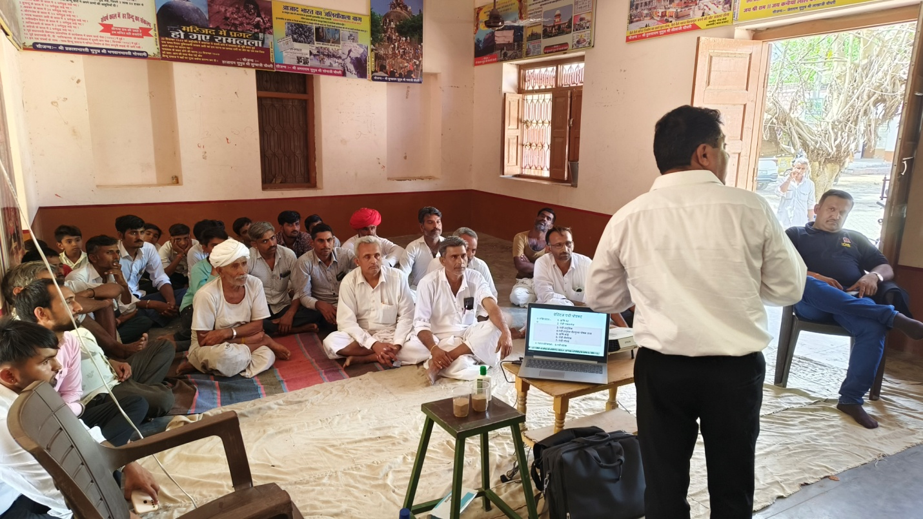

Slide 17
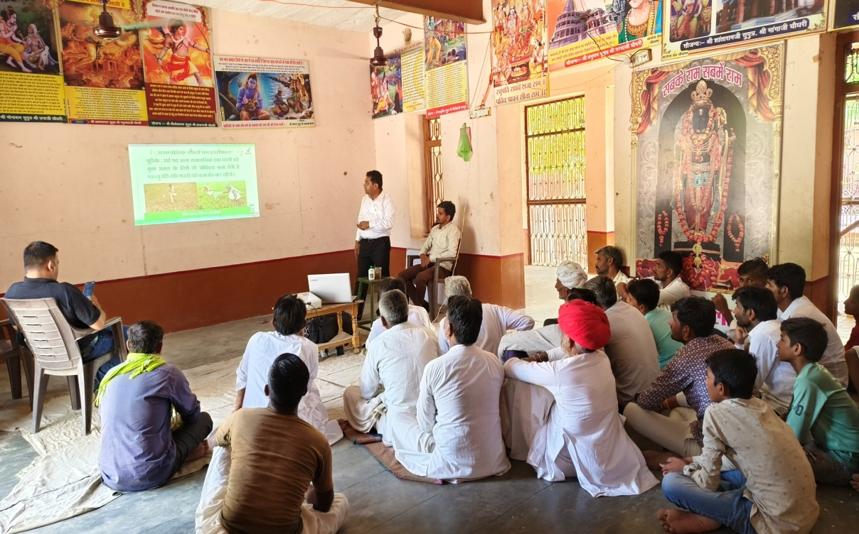
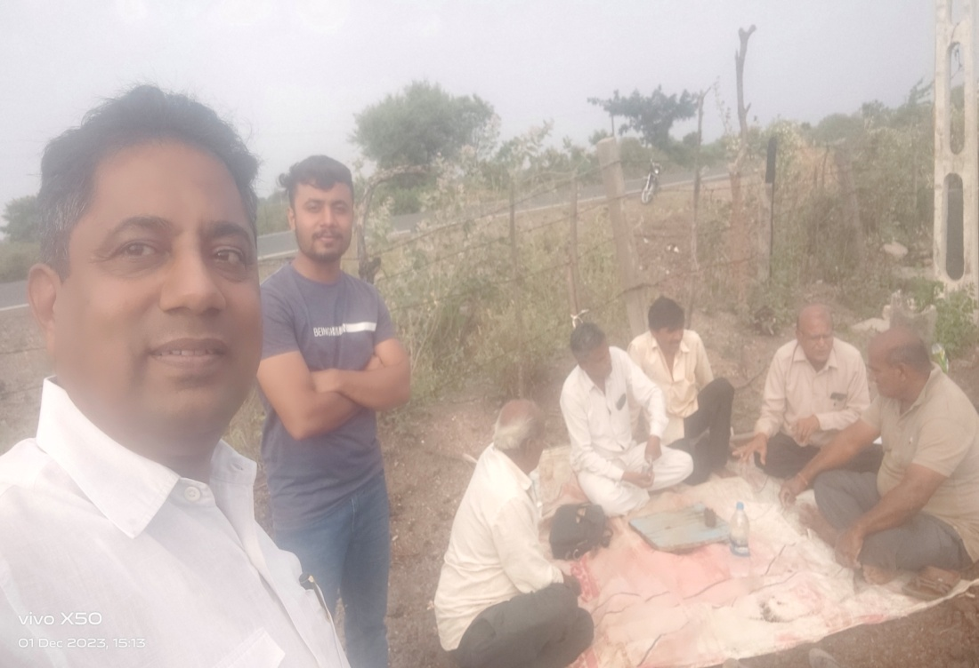
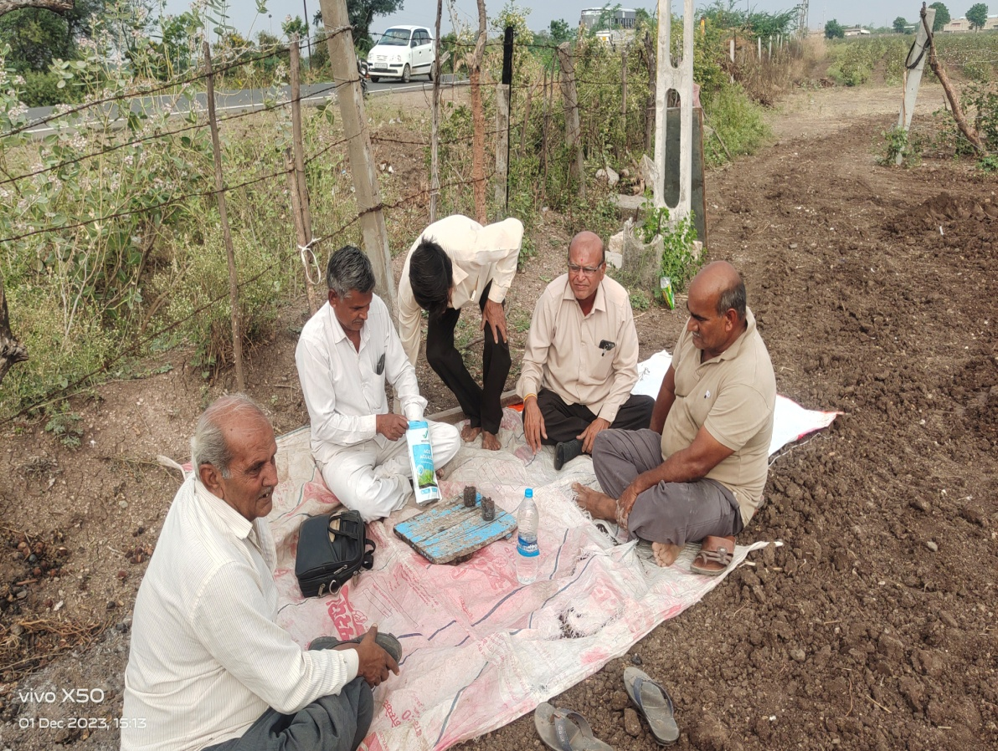
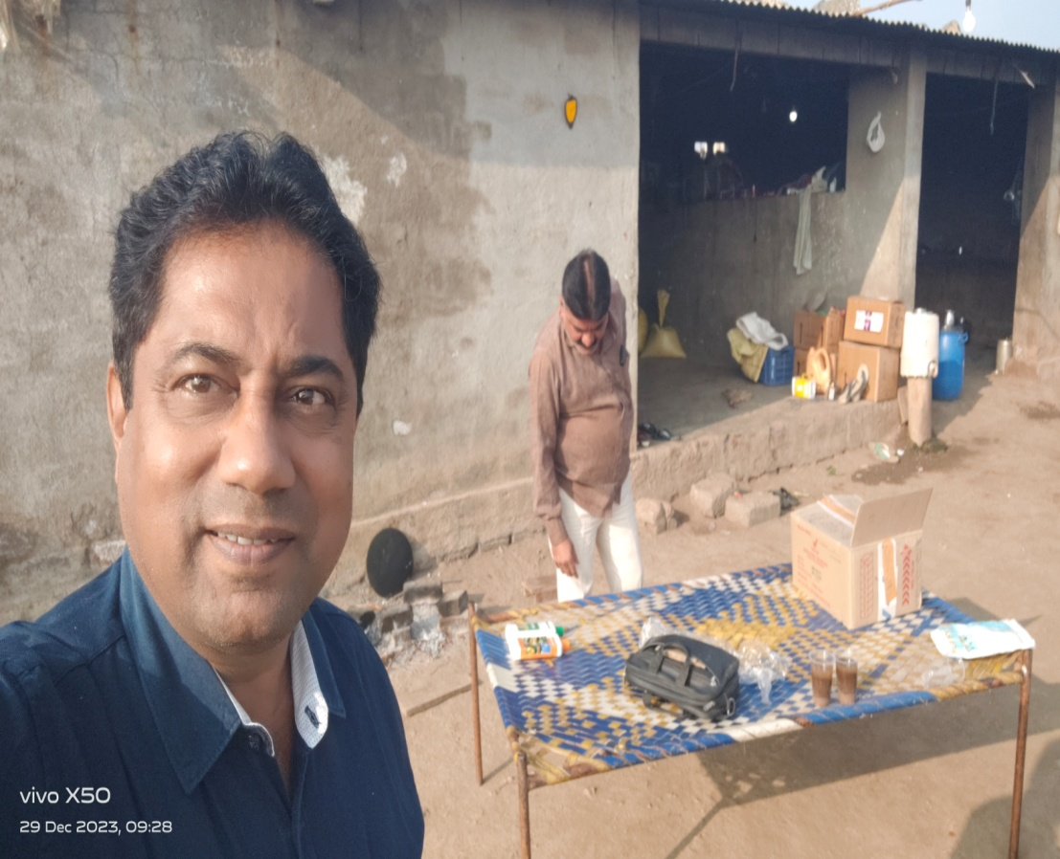

Slide 18


VESTIGE AGRI RETAIL EXAMPLE
HOUSE GARDEN WITH AGRI
AGRI PRODUCTS | DP/RATE (Rs) | MRP
AGRI HUMIC GRANULES | 740 | 1055
100 GRAM POUCH |  | 50
50 POUCH x 50 IN 1 WEEK |  | 2500
PROFIT IN 1 GRANUEL BAG | 2500-740 | 1760 Net.Proft
IN MONTH 4 GRANUEL BAG | 10000-2960 | 7040 Net.Proft

Slide 19

VESTIGE AGRI RETAIL EXAMPLE
AGRI PRODUCTS | DP/RATE (Rs) | MRP
AGRI HUMIC GRANULES | 740 | 1055
100 GRAM POUCH |  | 50
50 POUCH x 50 IN 1 WEEK |  | 2500
PROFIT IN 1 GRANUEL BAG | 2500-740 | 1760 Net.Proft
IN MONTH 4 GRANUEL BAG | 10000-2960 | 7040 Net.Proft

Slide 20
Go-Getter
CORE
CORE
CORE
CORE
CORE
CORE

